Slide 1
Image content based classification of
vacation/ tourism related images
16-074

Slide 2
Group members
Amjad M.N.M
Gunathilaka M.A.S.S
Weligampola L. P.
Gunasinghe S.U.

Slide 3
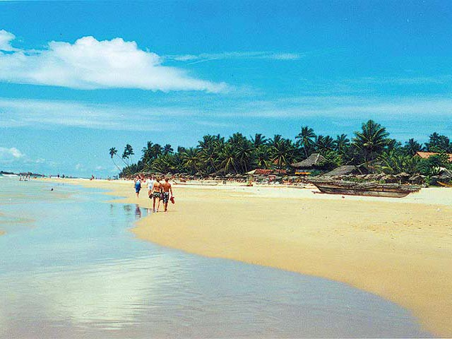
Image Segmentation
Divide the image into superpixels or multiple segments
Initially we need to load the image in order to process the image.

Slide 4
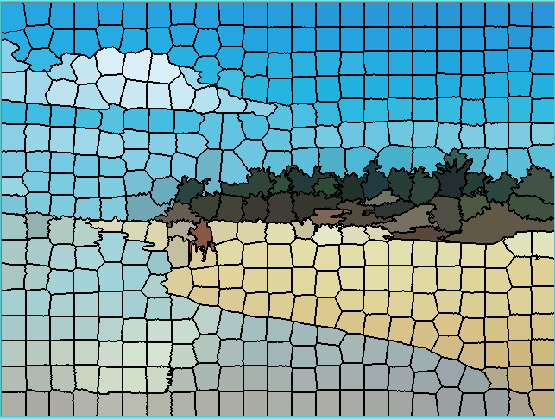
Image Segmentation contd...
Then we apply k means clustering algorithm to segment the image.
Original image
Max 400 segments

Slide 5
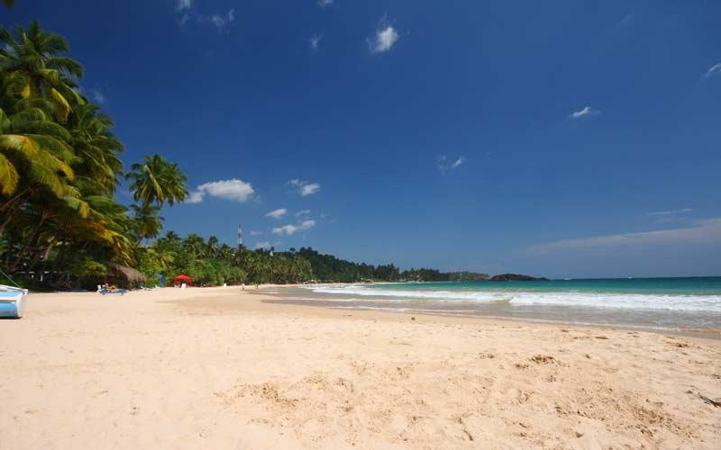
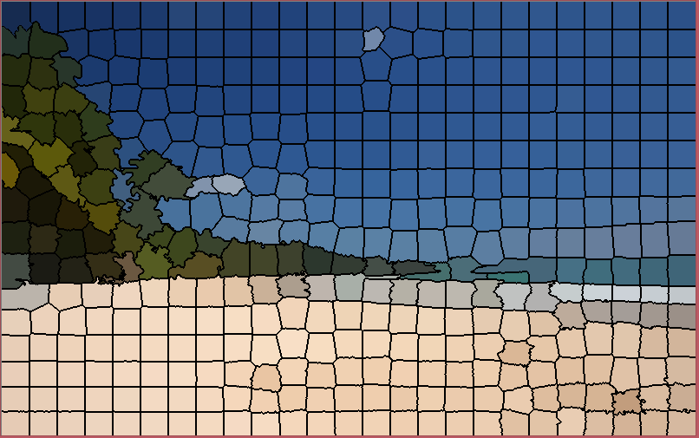
Image Segmentation contd...
Original image
Segmented image

Slide 6
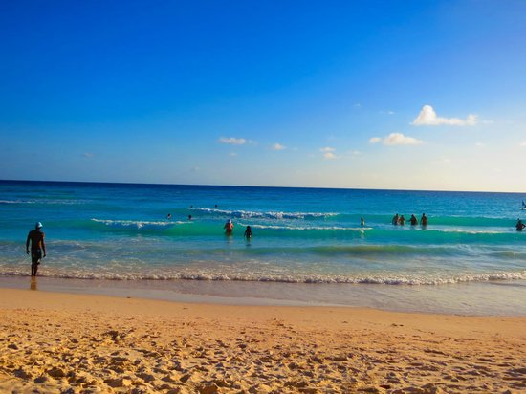
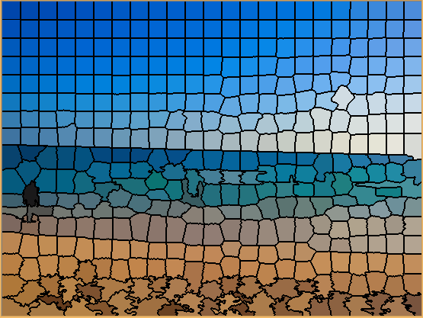
Image Segmentation contd...
Original image
Segmented image

Slide 7
Image Segmentation contd...
Then the segmented parts of the image need to be re-formed in order to create meaningful image segments or regions to separately classify them into labeled classes.

Slide 8
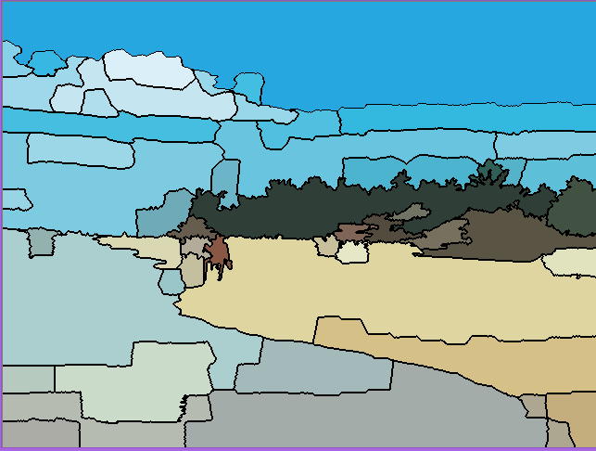
Object formation
Initially we take the segmented image and apply a threshold value to merge the super pixels of the image based on the adjacent segment’s colour.
But each image needs a different threshold value to segment properly.
Poorly formed image

Slide 9
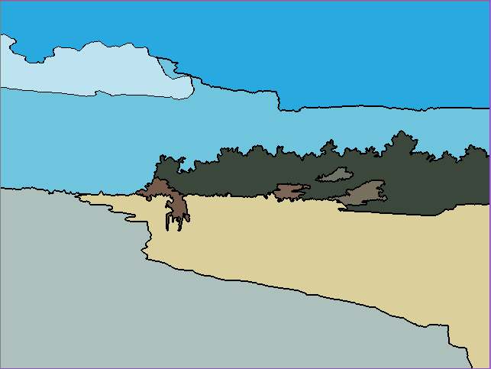
Object formation contd...
We created an algorithm to try out different threshold values until meaningful image regions are formed.
Generally 5 to 10 image segments are formed in the final output

Slide 10
This final output has a limited number of image segments which can be clearly classified into meaningful classes such as (sky, clouds, trees, sea, sand etc..)

Slide 11
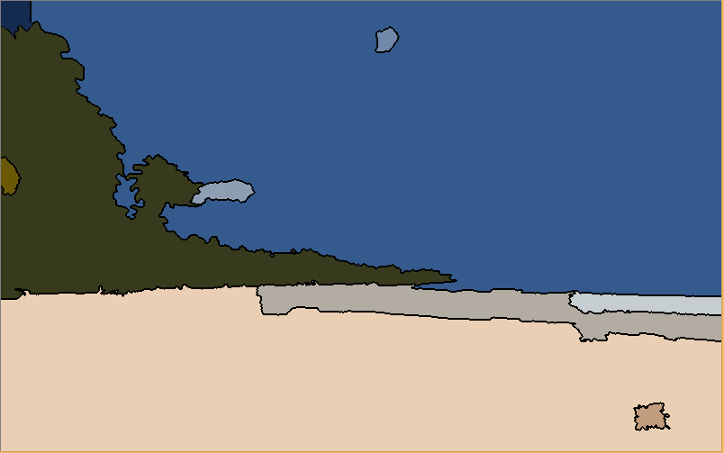
Formation contd...

Slide 12
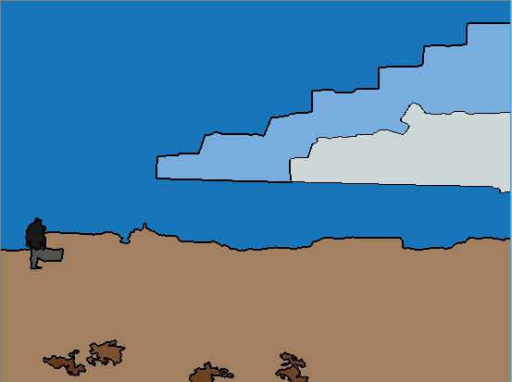
Formation contd...

Slide 13
Feature extraction
After forming the image segments, we developed an algorithm to extract features like
Red , Green, Blue value of each region
Pixel ratio of each formed region with respect to the total number of pixels in the image
Image segment’s shape information (Height, Width )

Slide 14
Region Shape Information
Region
Centroid
Boundary Box

Slide 15
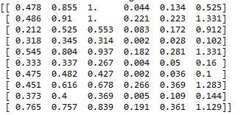
Feature extraction contd...
Then we create a feature vector using the extracted information and this information is passed to the neural network.

Slide 16
Object identification and classification
After the initial input images are segmented the segmented image data needs to be passed to the neural network to be identified and classified
our goal is to identify the segments in the scenery image and output all the classes of identified by the neural network.
For that we use a Neural Network

Slide 17
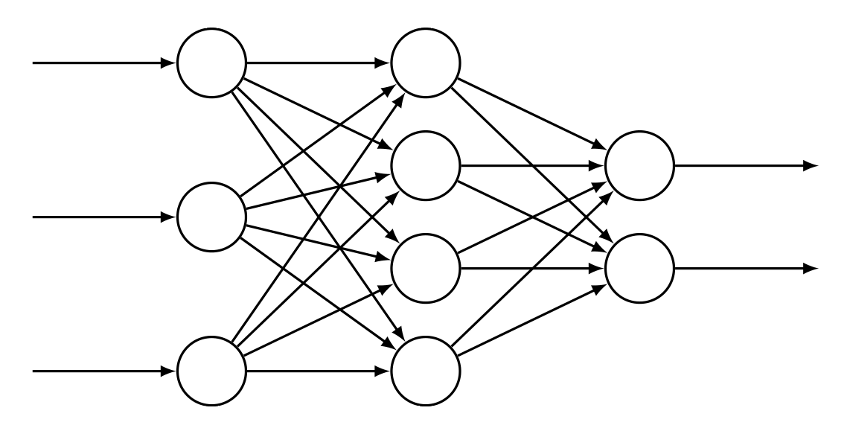
Neural network
Feature vector is input to the neural network, process the data and output the result.

Slide 18
Predict the output
We implemented a feedforward neural network which processes the input data in the hidden layers and predict the classes identified as output.
Input image data
Output class
Input image data
Output class
Input image data

Slide 19
Training the neural network
For the neural network to successfully identifying the regions in the image, we need to train the neural network with training data.
For that we devised a training module which trains the neural network with multiple image objects of the same class and for all the classes available.

Slide 20
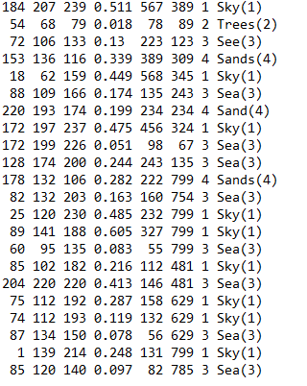
Training the neural network contd...
Training function
Train image objects

Slide 21
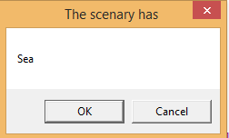
Training the neural network contd...
So when an image is input to the neural network, it predicts the identified classes as outputs.
This image has a sea
This image has a sky
This image has trees
This image has sands
Feature vector
Beach

Slide 22
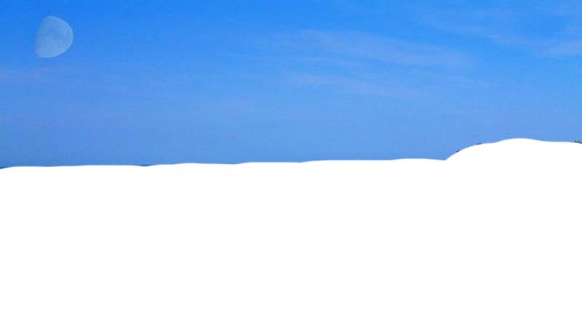
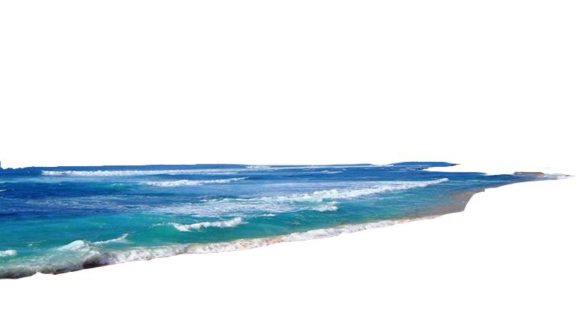
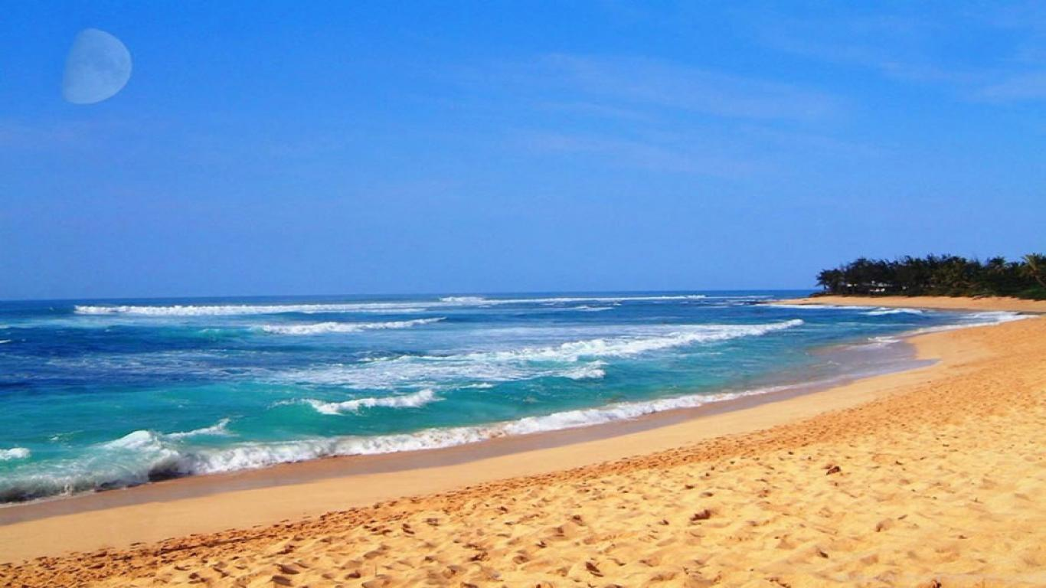
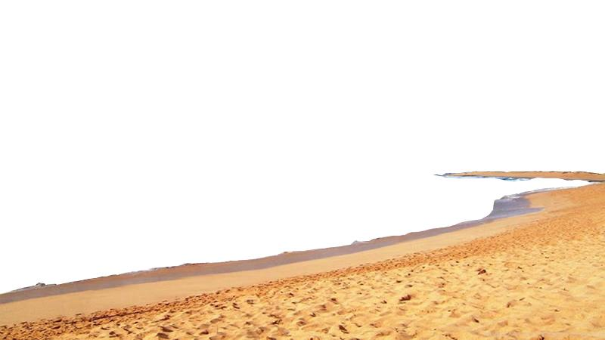
Sample image segments

Slide 23
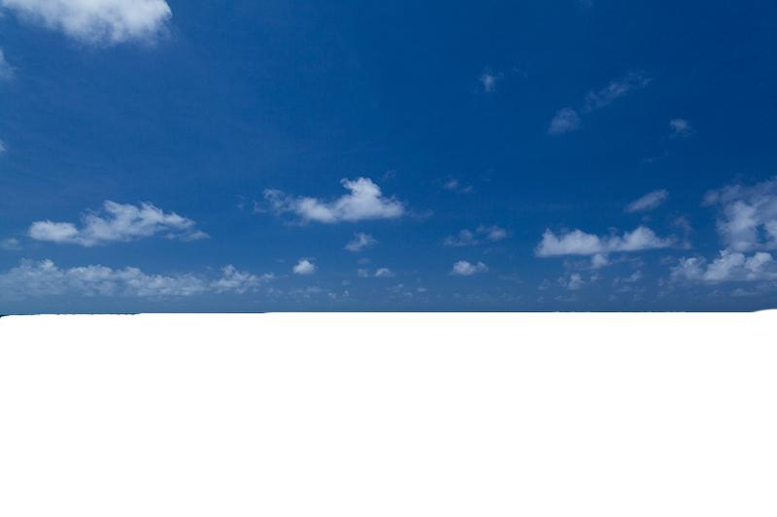



Sample image segments

Slide 24
Let’s go to the demo

